Slide 1
Dispelling Software Engineering Myths:
A Pragmatic Causal Inference Approach
Thesis Defense, September 21, 2026
Hao He
haohe@andrew.cmu.edu
Ph.D. Student in Software Engineering
Carnegie Mellon University

Slide 2
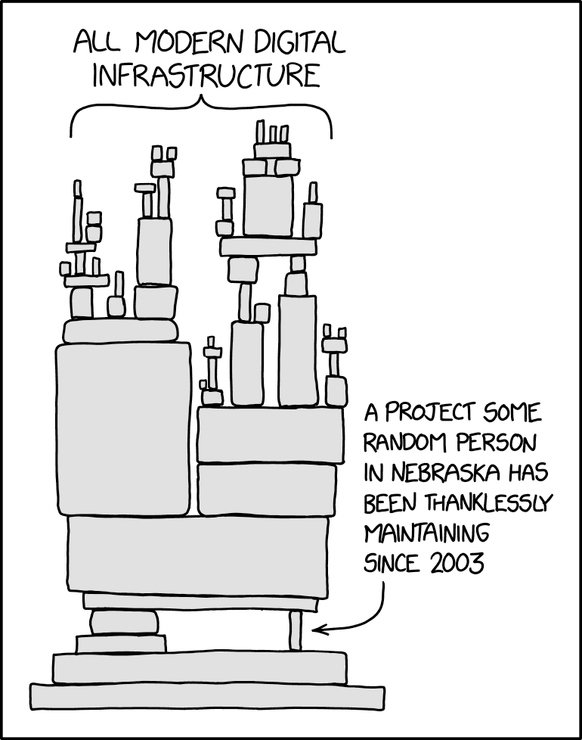
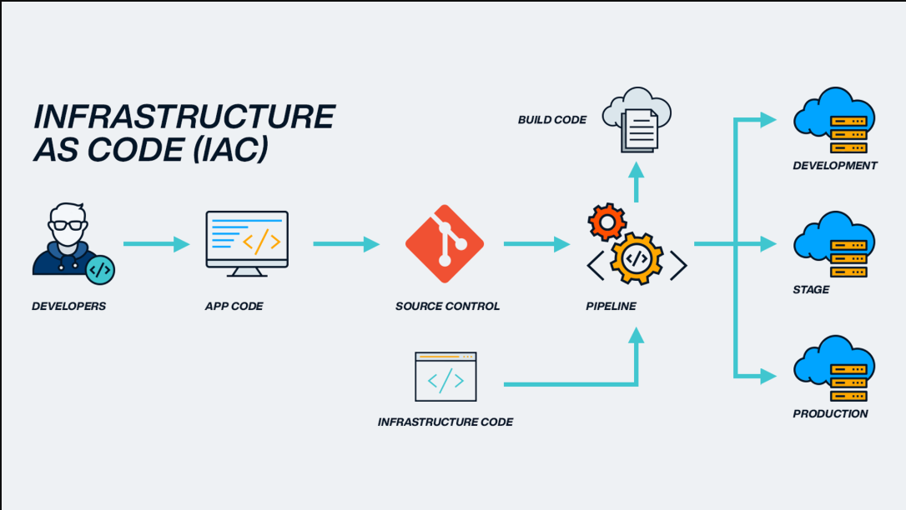
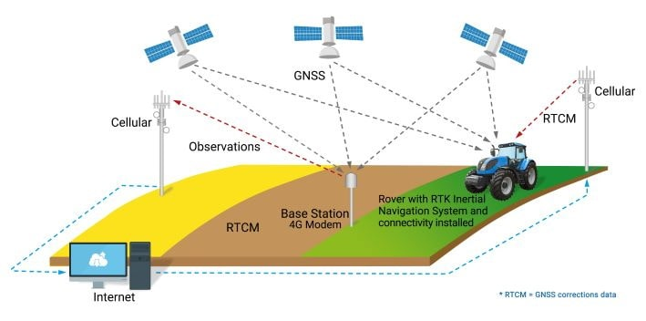

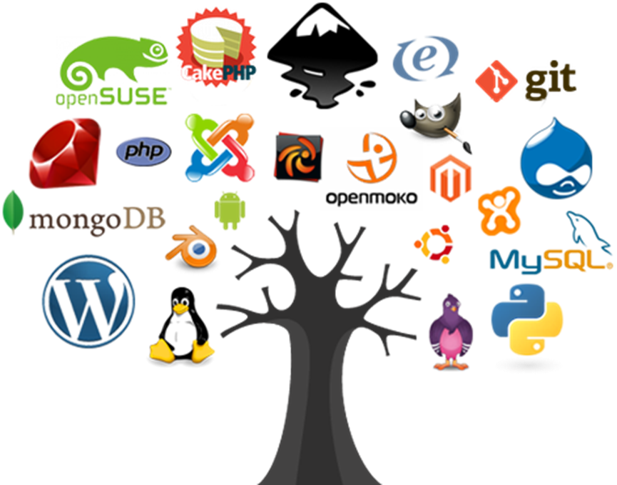
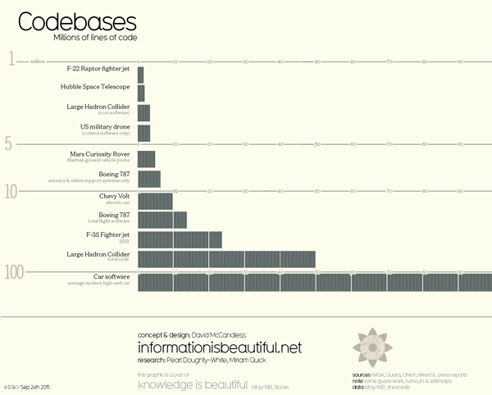
Software engineering is one of the most consequential engineering disciplines in the modern era

Slide 3

However, software engineering practice today is filled with myths
Software Engineering Myths: widely held beliefs derived from intuition, experience, and conventional wisdom, that have never been rigorously tested or, when tested, have produced inconclusive or contradictory results

Slide 4
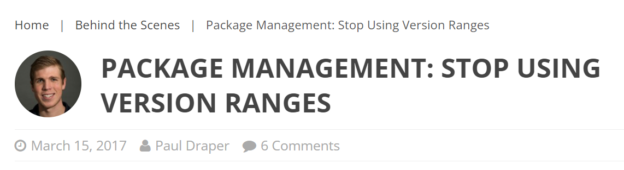
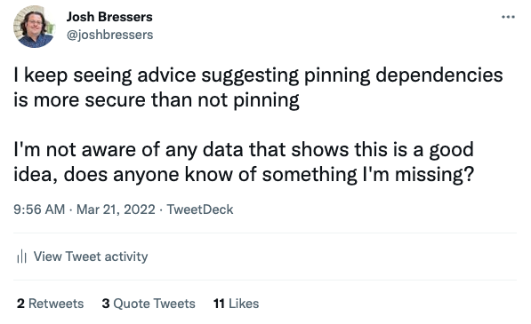
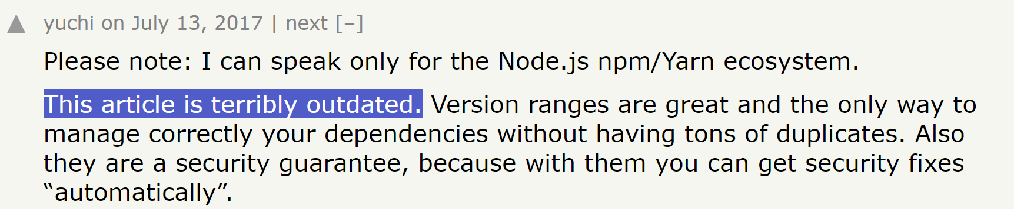
Example 1: Pinning vs. Floating

Slide 5
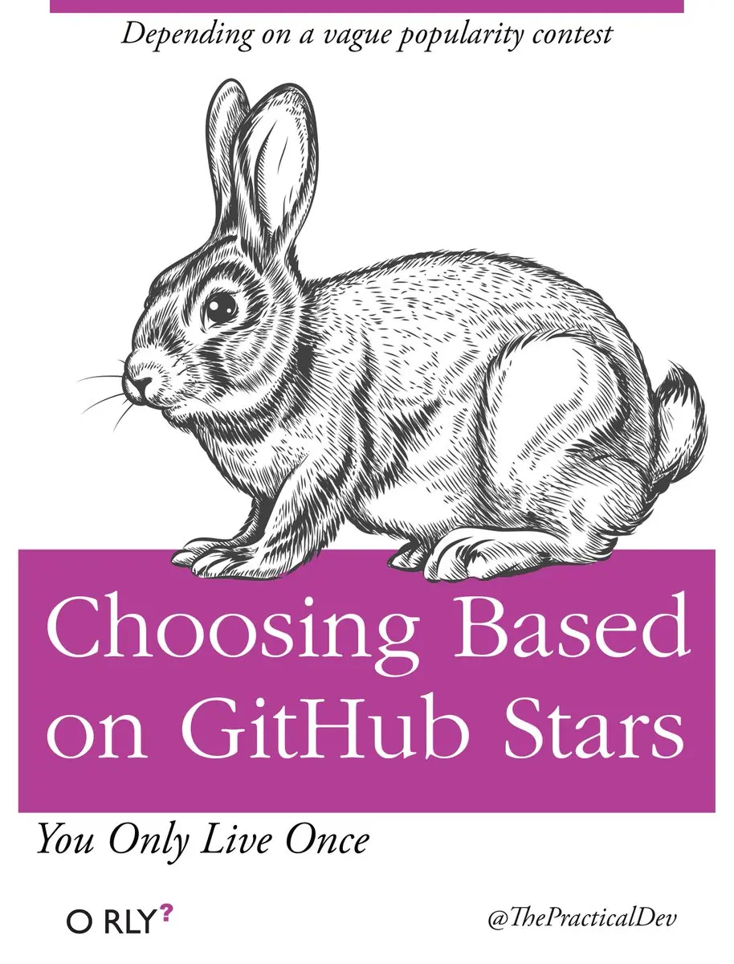
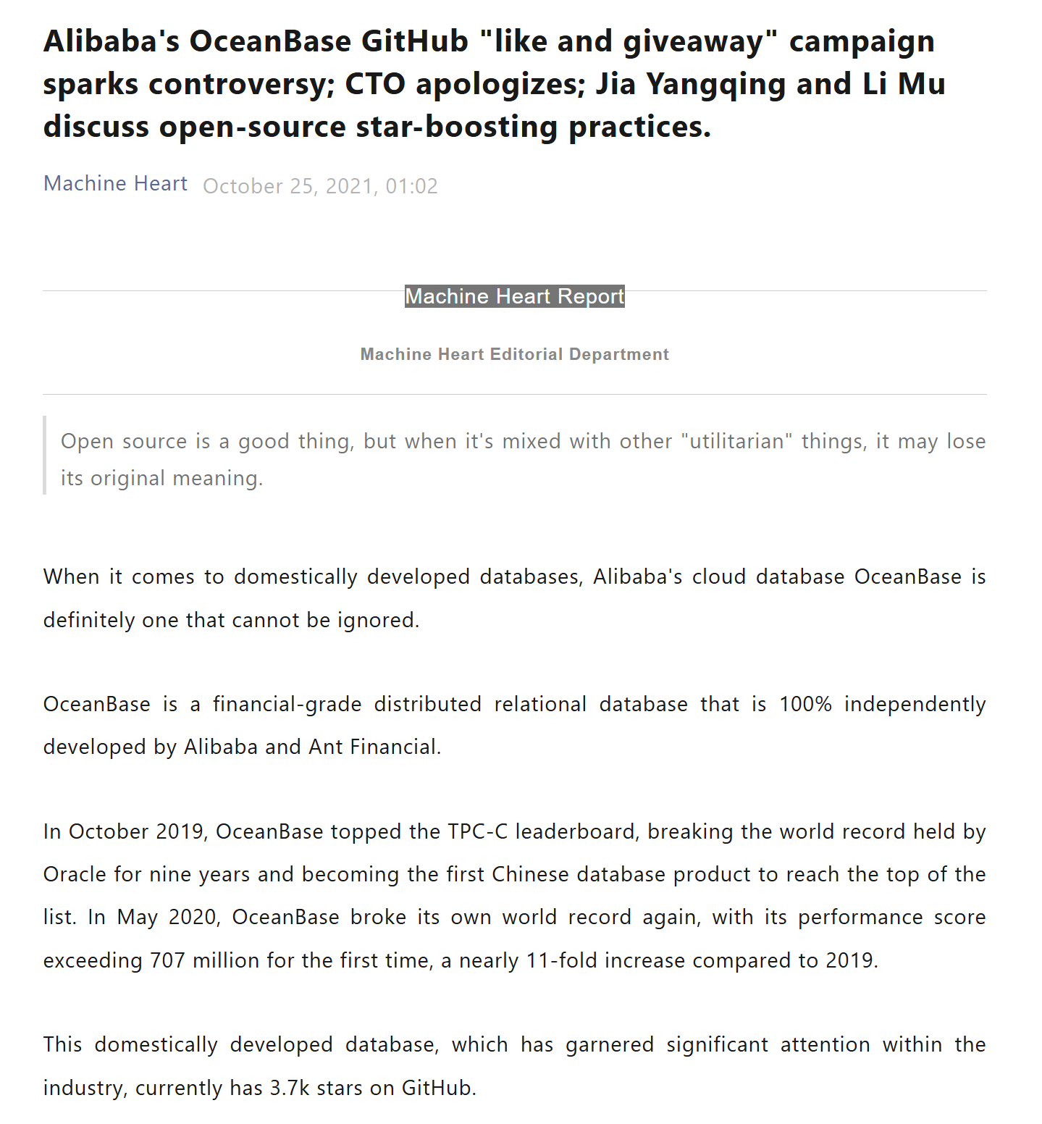
Example 2: GitHub Stars for Growth Hacking

Slide 6
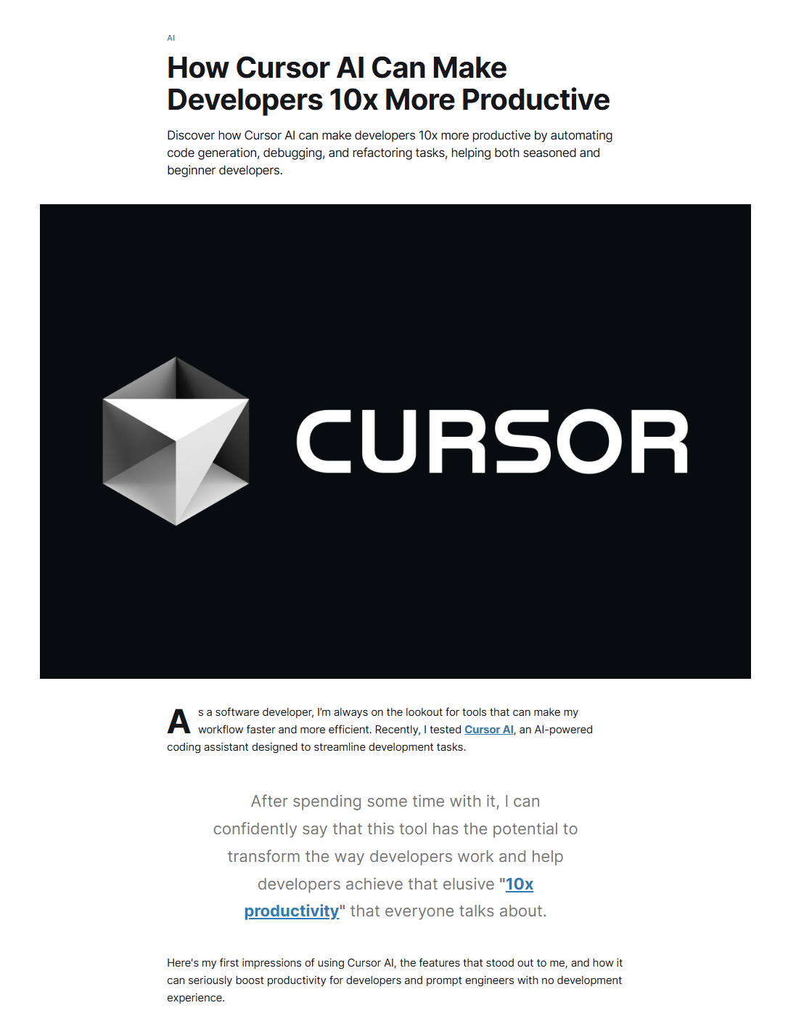
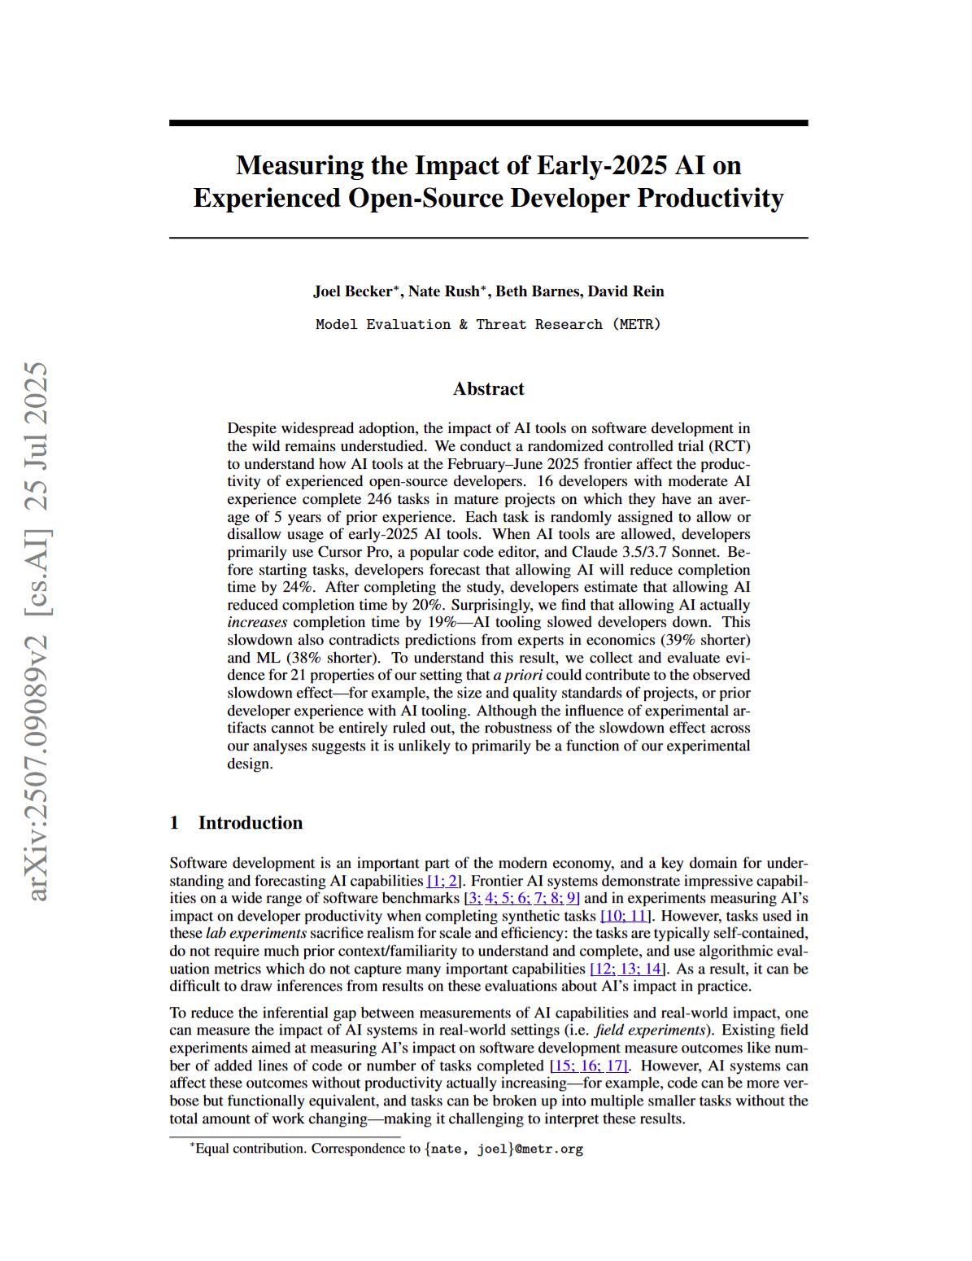
Example 3: AI Coding Tools on Productivity
Open-source developers work on their daily tasks slower with Cursor AI in early 2025

Slide 7
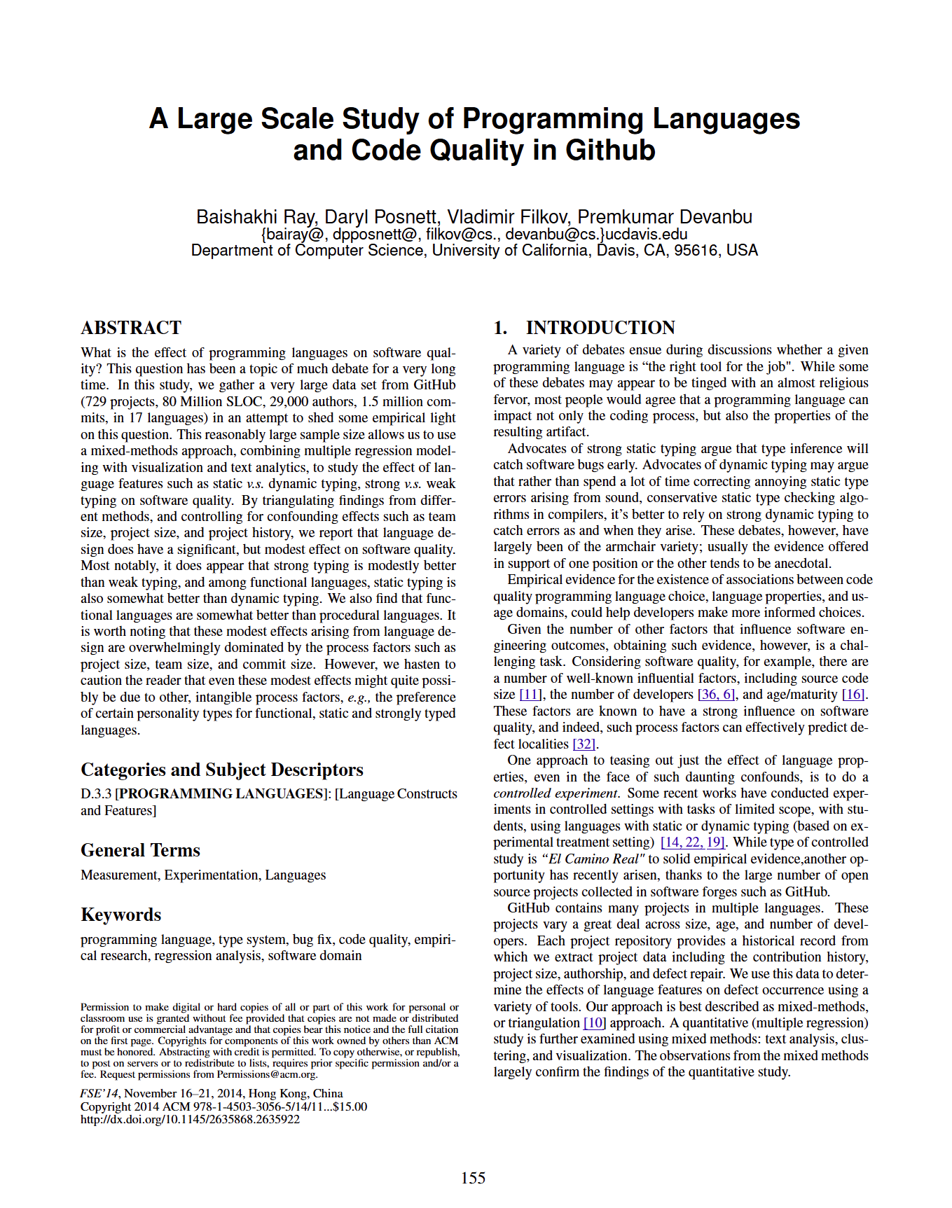
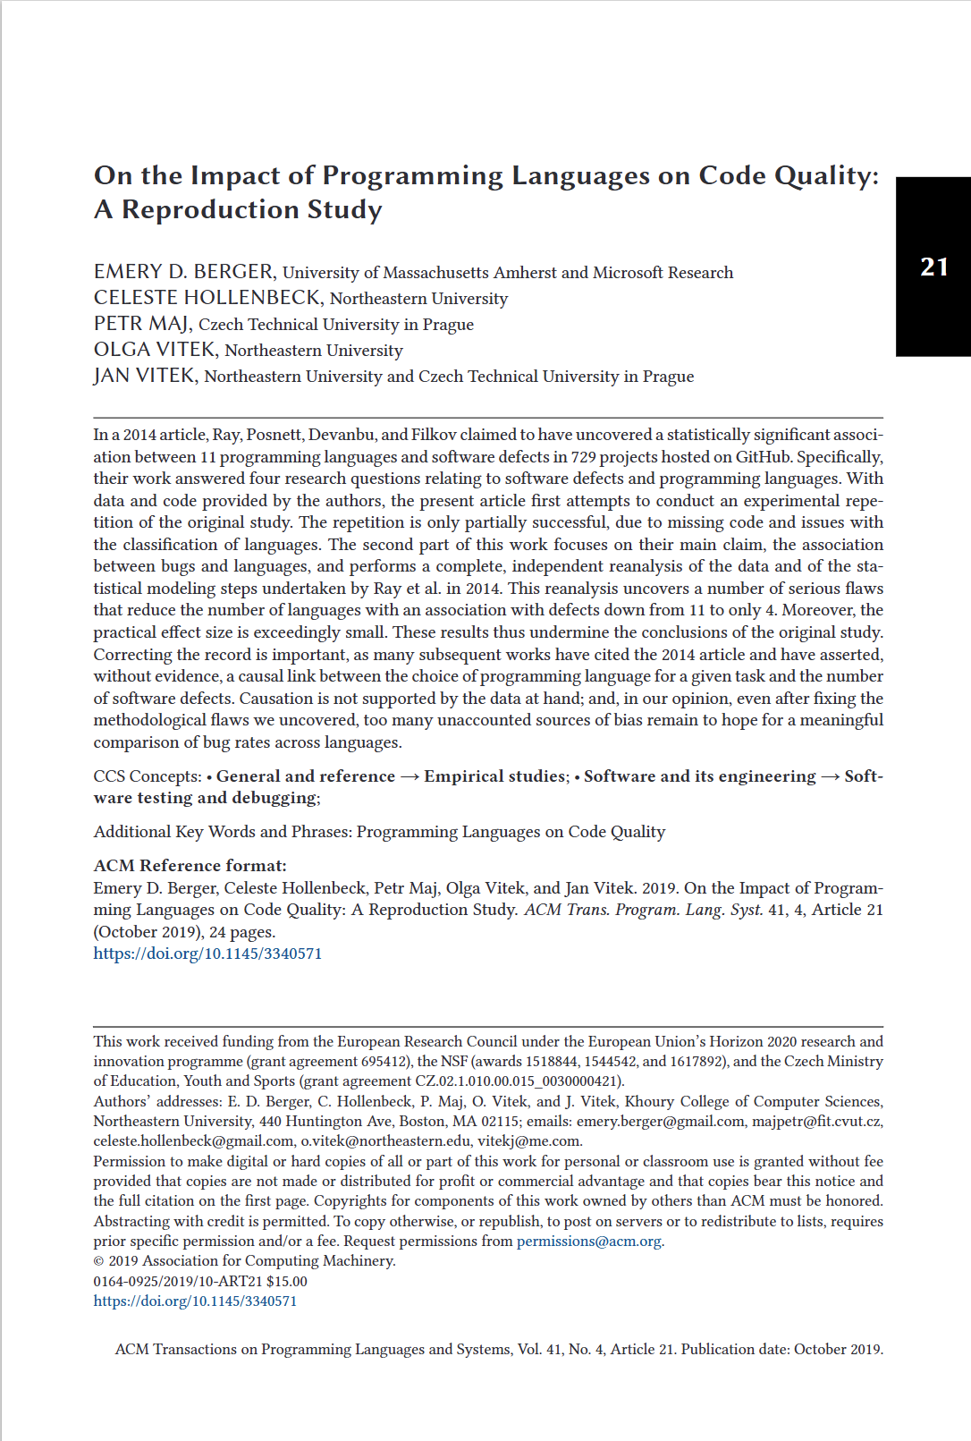
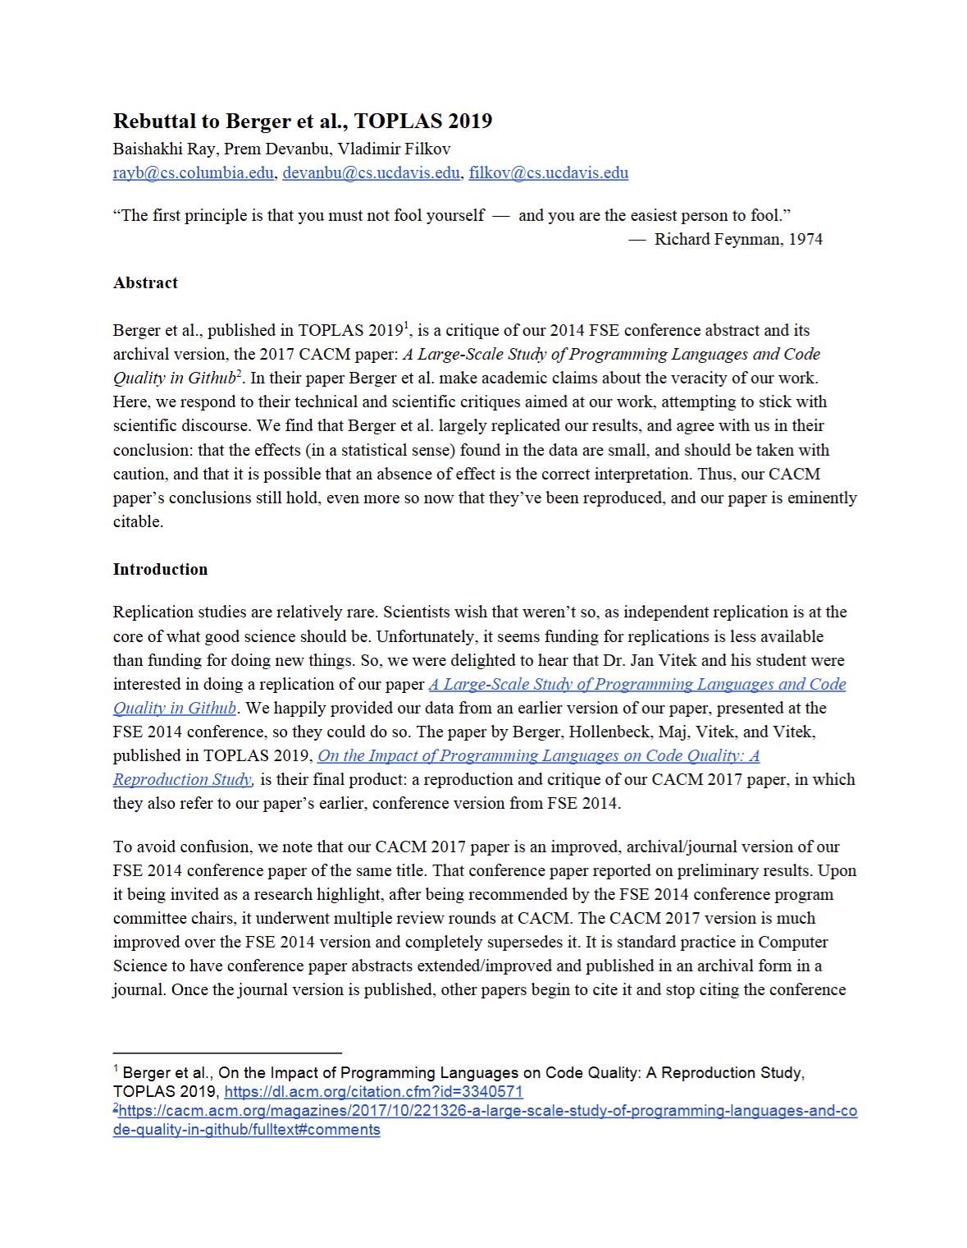
Example 4: Programming Language vs. Defect Proneness

Slide 8
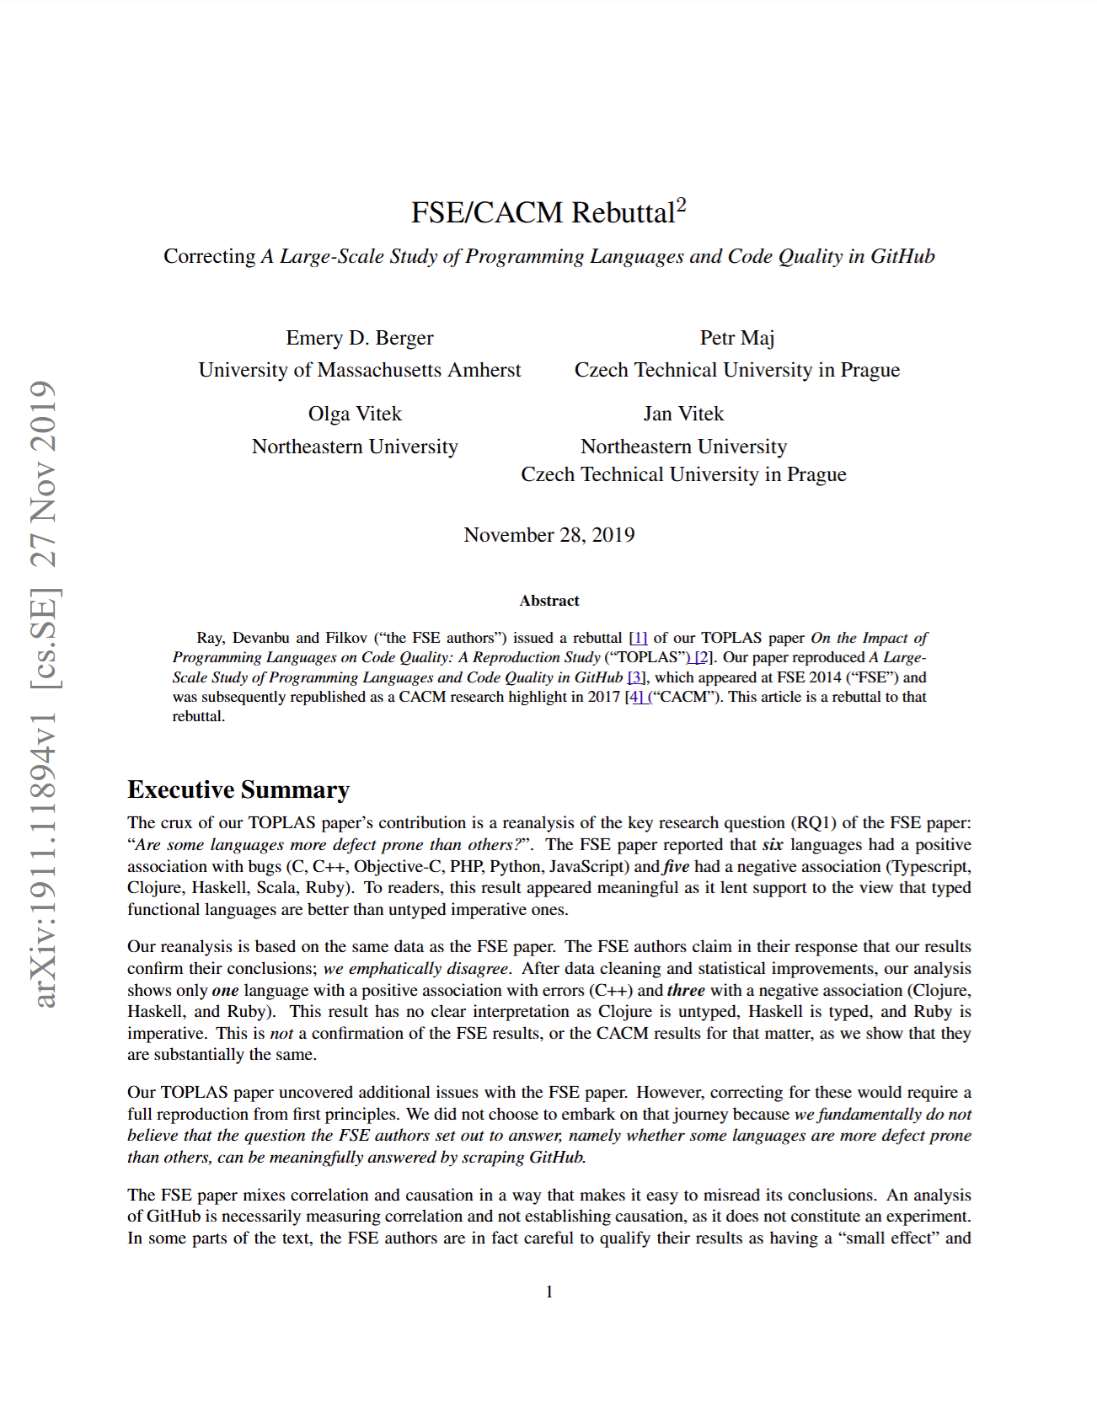
Example 4: Programming Language vs. Defect Proneness
“We fundamentally do not believe that the question the FSE authors set out to answer, namely whether some languages are more defect prone than others, can be meaningfully answered by scraping GitHub.”
REALLY?
Is it impossible to meaningfully settle important software engineering myths?

Slide 9
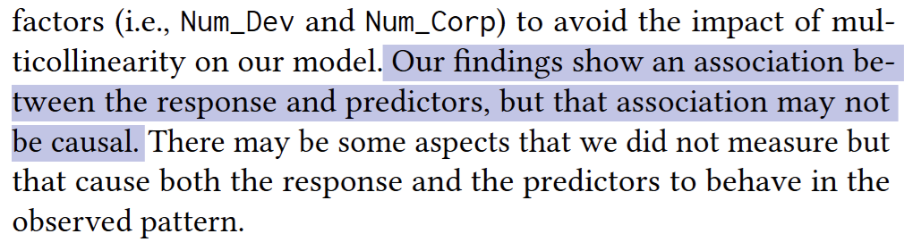
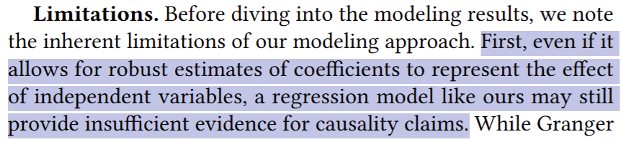
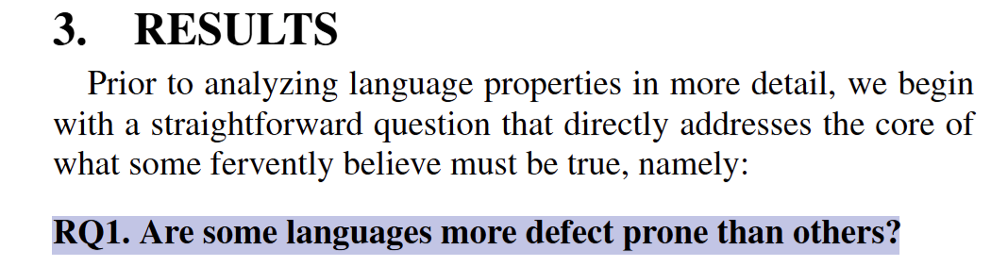
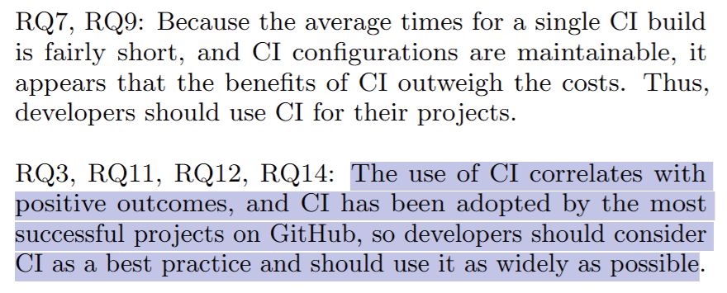
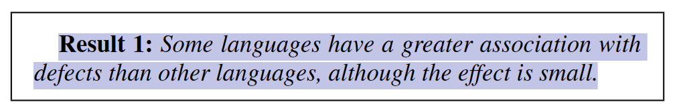
Common Pattern: Claiming to be only studying correlation when the research question is fundamentally a question about causal relationships

Slide 10
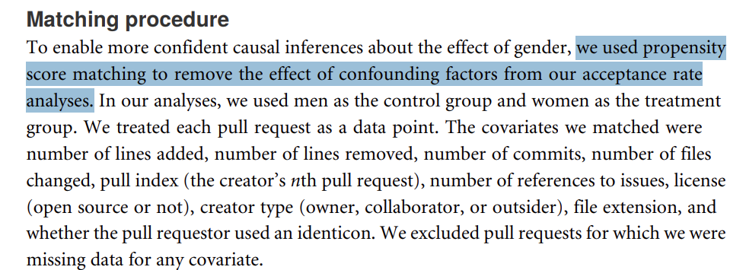
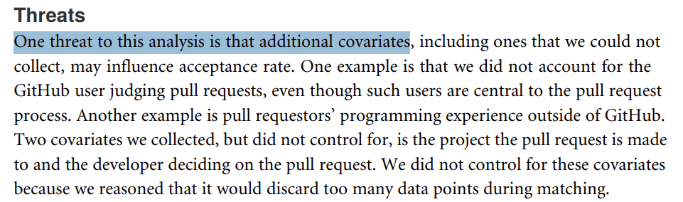
Even a “causal inference” method is claimed, SE research may fail to discuss the nuance of underlying assumptions and when you can make a causal claim
Example: Use propensity score matching without assessing the conditional ignorability assumption
Example: Believe that experiment is golden standard without assessing if randomization can be truly achieved
  Believe that a small sample (N=30) achieve sufficient randomization
  Randomization on non-randomizable treatment
    e.g., compare men vs. women in software engineering
    => strong selection bias in place

Slide 11
Without a framework and language of causal credibility, one has to be an expert to assess the strength of causal claims in each paper

Slide 12


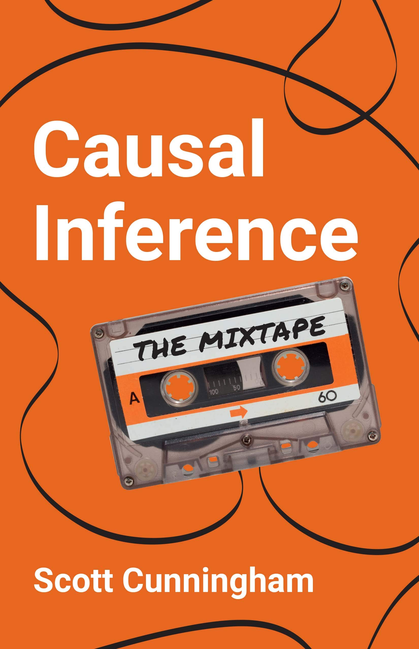
The Art of Causal Inference on Observational Data

Slide 13
Causal Directed Acyclic Graphs (DAGs)
A way of formally specifying causal relationships
Much more nuanced than what we show here, see: https://mixtape.scunning.com/03-directed_acyclical_graphs
Direct Relationship
Programming Language
Defect Proneness
Confounders
Task Difficulty
Mediators
Team Skill
Code Complexity
Defect Proneness
Colliders / Backdoors (not shown here for brevity)

Slide 14
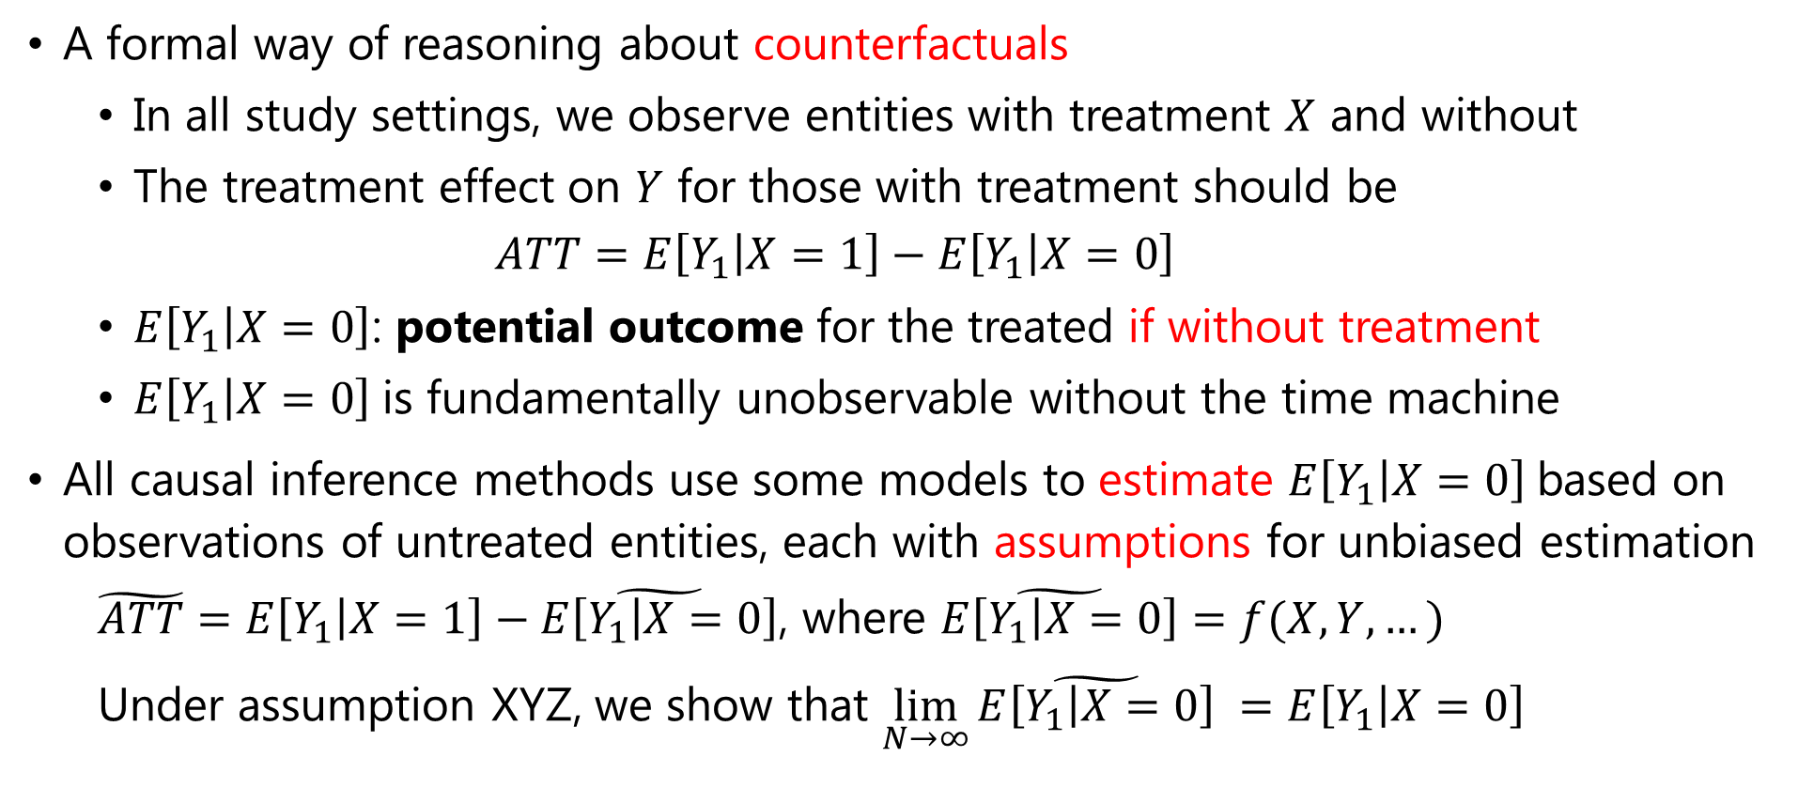
The Potential Outcome Framework
A formal way of reasoning about counterfactuals
  In all study settings, we observe entities with treatment $X$ and without
  The treatment effect on $Y$ for those with treatment should be
    $$ATT=E\left[Y_{1} | X=1\right]−E\left[Y_{1} | X=0\right]$$
  $E\left[Y_{1} | X=0\right]$: potential outcome for the treated if without treatment
  $E\left[Y_{1} | X=0\right]$is fundamentally unobservable without the time machine
All causal inference methods use some models to estimate $E\left[Y_{1} | X=0\right]$based on observations of untreated entities, each with assumptions for unbiased estimation
  $\tilde{ATT}=E\left[Y_{1} | X=1\right]−\tilde{E\left[Y_{1} | X=0\right]}$, where $\tilde{E\left[Y_{1} | X=0\right]}=f(X,Y,…)$
  Under assumption XYZ, we show that $\lim_{N→∞}{\tilde{E\left[Y_{1} | X=0\right]}} =E\left[Y_{1} | X=0\right]$

Slide 15
The Modern Weaponry for Causal Inference
Regression Discontinuity Design
Matching
Difference in Differences
Fixed Effects and Panel Regression
Randomized Experiments
Natural Experiments
Instrumental Variables
High Internal Validity
High External Validity

Slide 16
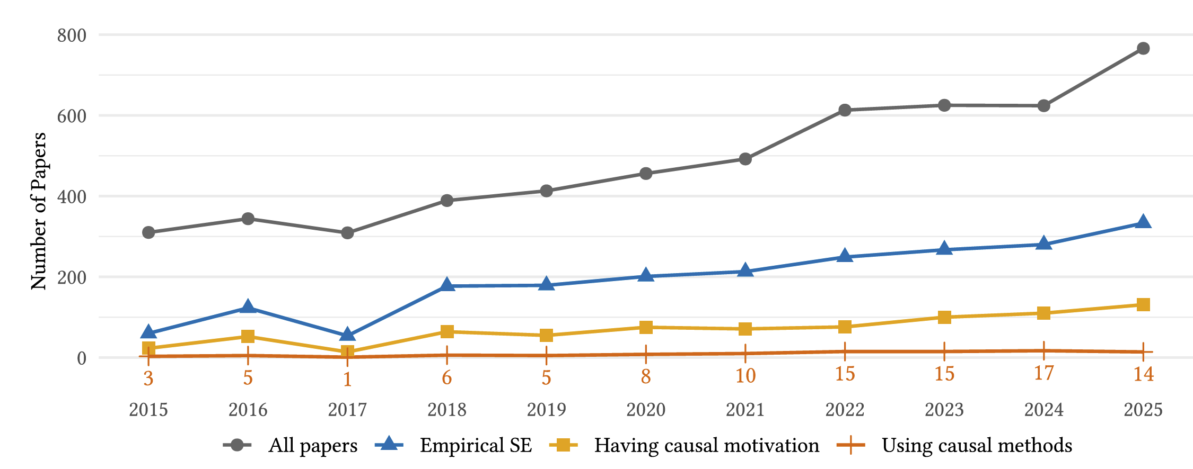
It has been used in software engineering, but not that much
Figure: Publication trends at ICSE, FSE, and ASE (2015–2025)

Slide 17
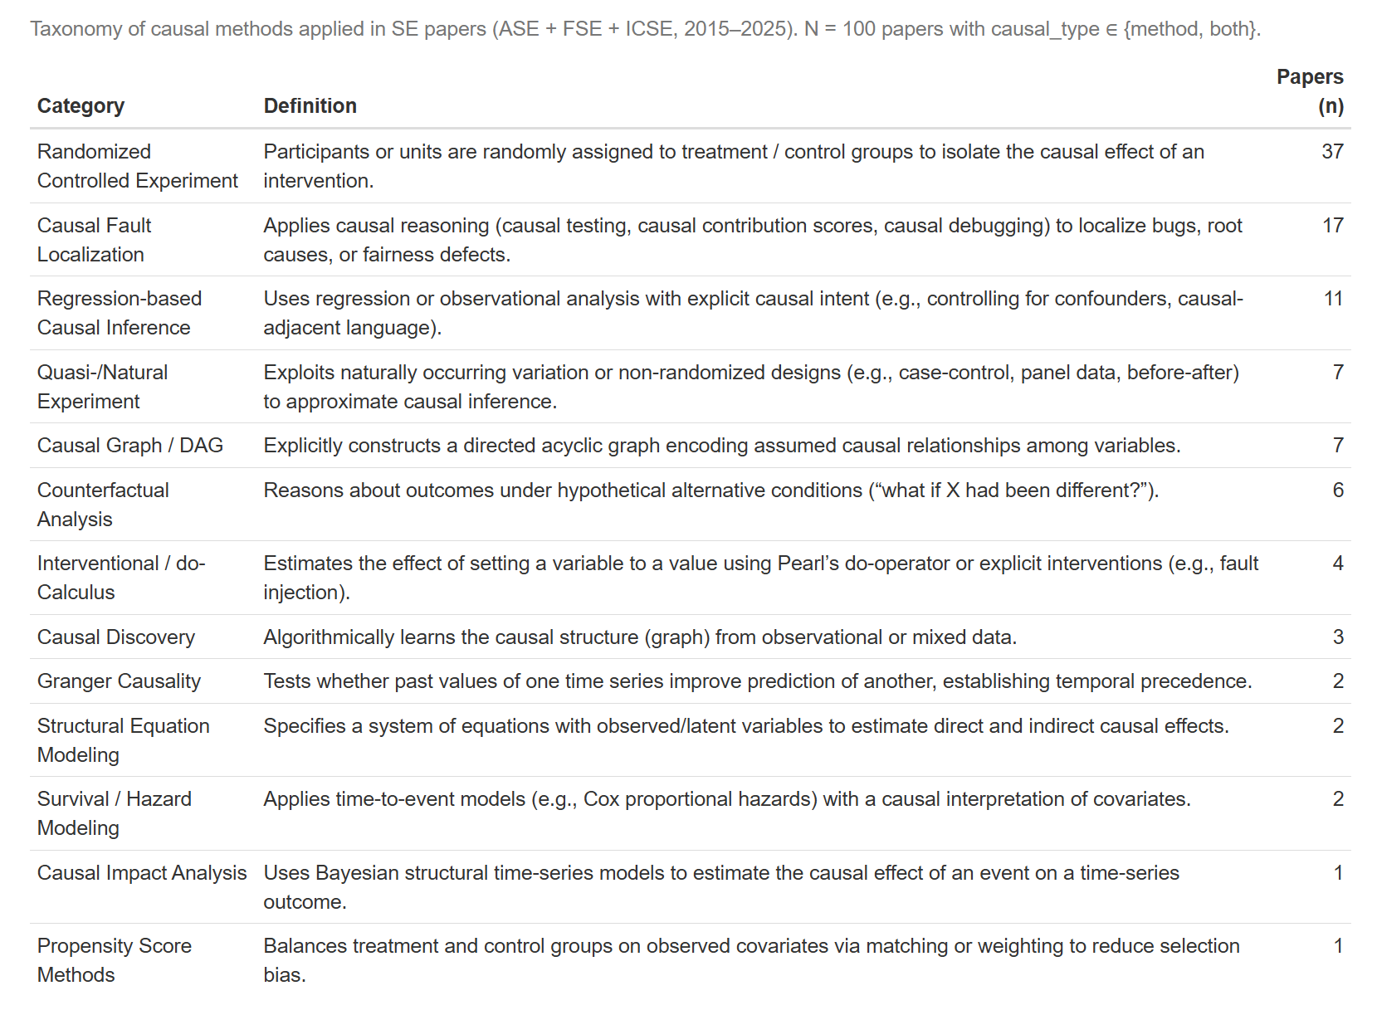

Slide 18
Thesis Statement
I argue that causal credibility assessments are feasible in empirical software engineering through an explicit articulation of causal theory and assumptions.
One feasible causal credibility assessment operationalization in SE settings is as follows:
  Derive a causal theory from existing SE domain knowledge
  Define a causal estimate of interest and the assumption under which the estimate would carry a causal interpretation through the potential outcome framework
  Honestly acknowledge and mitigate limitations in data collection, metric design, measurement infrastructure, and model specifications
  Thoughtfully navigate alternative explanations (i.e., alternative DAGs)
Notes:
Applying the thesis framework is feasible for dispelling software engineering myths and inform evidence-based practice. Do an educational paper instead of the migration

Slide 19
The Impact of Dependency Pinning on Supply Chain Security
Empirical Study I
Hao He, Bogdan Vasilescu, and Christian Kästner. “Pinning Is Futile: You Need More Than Local Dependency Versioning to Defend against Supply Chain Attacks.” Proceedings of the ACM on Software Engineering 2.FSE (2025), Article FSE013, pp. 266–289. Preprint: arXiv:2502.06662.

Slide 20
The Impact of Dependency Pinning on Supply Chain Security
Research Question: Does pinning dependency versions affect software projects’ vulnerability to software supply chain attacks?
reduces
Pinning Dependencies
Attack Surface
Candidate Theory (The Myth)
He, Hao, Bogdan Vasilescu, and Christian Kästner. "Pinning is Futile: You Need More Than Local Dependency Versioning to Defend Against Supply Chain Attacks." Proceedings of the ACM on Software Engineering 2.FSE (2025): 266-289. 🏆Distinguished Paper Award

Slide 21
Completed Work : Pinning vs. Floating
Research Question: Does pinning dependency versions affect software projects’ vulnerability to software supply chain attacks?
Dependency Graph Size
mediates
Pinning Dependencies
Attack Surface
mediates
Dependency Resolution Algorithm
Alternative Theory
He, Hao, Bogdan Vasilescu, and Christian Kästner. "Pinning is Futile: You Need More Than Local Dependency Versioning to Defend Against Supply Chain Attacks." Proceedings of the ACM on Software Engineering 2.FSE (2025): 266-289. 🏆Distinguished Paper Award

Slide 22
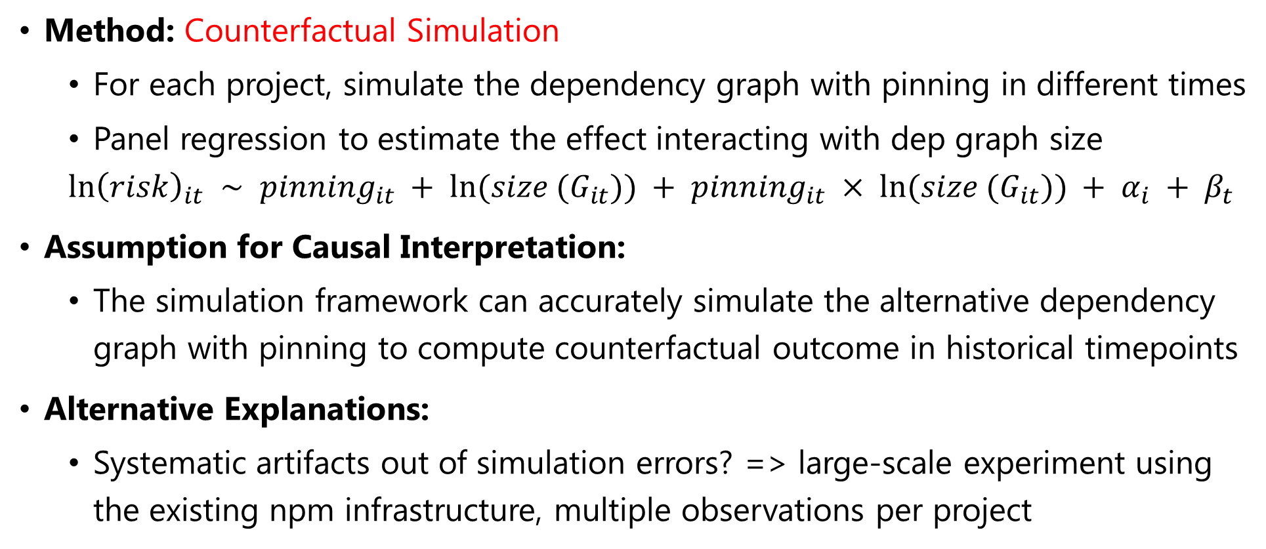
Completed Work: Pinning vs. Floating
Method: Counterfactual Simulation
  For each project, simulate the dependency graph with pinning in different times
  Panel regression to estimate the effect interacting with dep graph size
  $$ln{\left(risk\right)}_{it} ∼ pinning_{it} + ln(size (G_{it})) + pinning_{it} × ln(size (G_{it})) + α_{i} + β_{t}$$
Assumption for Causal Interpretation:
  The simulation framework can accurately simulate the alternative dependency graph with pinning to compute counterfactual outcome in historical timepoints
Alternative Explanations:
  Systematic artifacts out of simulation errors? => large-scale experiment using the existing npm infrastructure, multiple observations per project

Slide 23
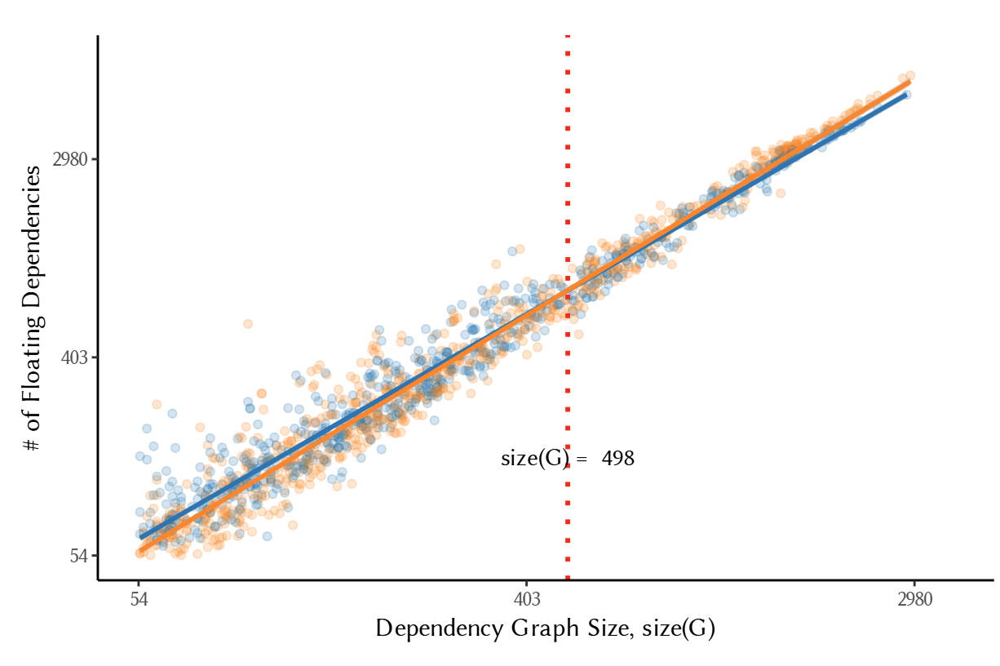
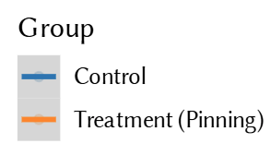
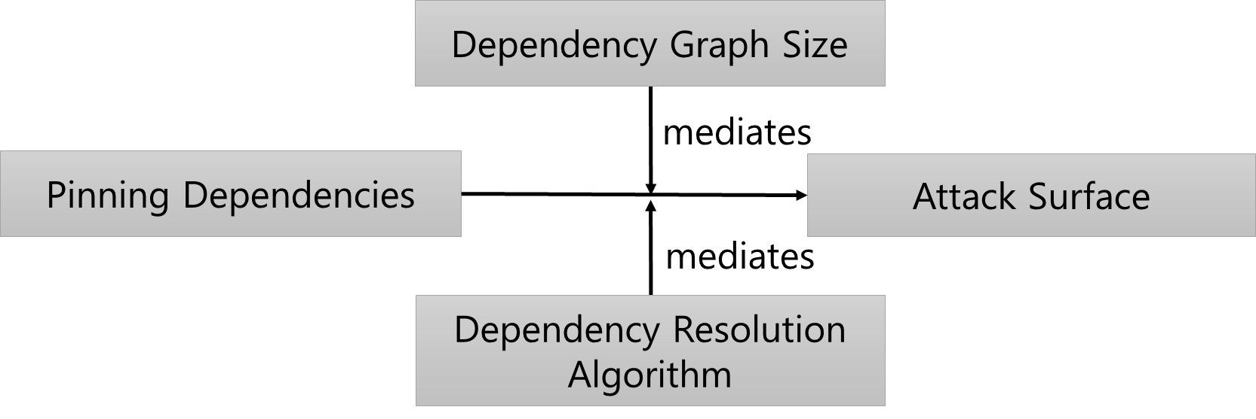
Completed Work: Pinning vs. Floating
×(dispelled) Candidate Theory 1 (The Myth)
√(supported) Candidate Theory 2

Slide 24
The Impact of Fake GitHub Stars on Repository Promotion
Empirical Study II
Hao He, Haoqin Yang, Philipp Burckhardt, Alexandros Kapravelos, Bogdan Vasilescu, and Christian Kästner. “Six Million (Suspected) Fake Stars on GitHub: A Growing Spiral of Popularity Contests, Spam, and Malware.” In Proceedings of the 48th International Conference on Software Engineering (ICSE’26), Rio de Janeiro, Brazil, 2026. Preprint: arXiv:2412.13459.

Slide 25
Completed Work: The Effect of Fake GitHub Stars
Research Question: Does artificially inflating GitHub stars create a promotional effect, making people more likely to star the target repositories?
increases
Fake GitHub Stars
Real GitHub Stars
Candidate Theory (The Myth)
He, Hao, et al. "Six Million (Suspected) Fake Stars on GitHub: A Growing Spiral of Popularity Contests, Spam, and Malware." Proceedings of the 48th International Conference on Software Engineering (ICSE’26). 2026.

Slide 26
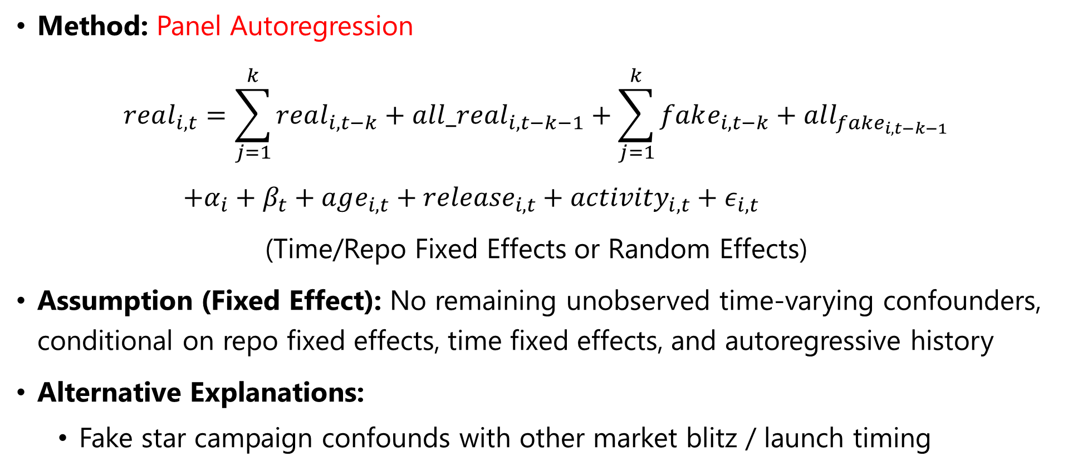
Completed Work: The Effect of Fake GitHub Stars
Method: Panel Autoregression
$$real_{i,t}=\sum_{j=1}^{k}{real_{i,t−k}+all_real_{i, t−k−1}}+\sum_{j=1}^{k}{fake_{i,t−k}}+all_{fake_{i,t−k−1}}$$
$+α_{i}+β_{t}+age_{i,t}+{release}_{i,t}+activity_{i,t}+ε_{i,t}$
(Time/Repo Fixed Effects or Random Effects)
Assumption (Fixed Effect): No remaining unobserved time-varying confounders, conditional on repo fixed effects, time fixed effects, and autoregressive history
Alternative Explanations:
  Fake star campaign confounds with other market blitz / launch timing

Slide 27
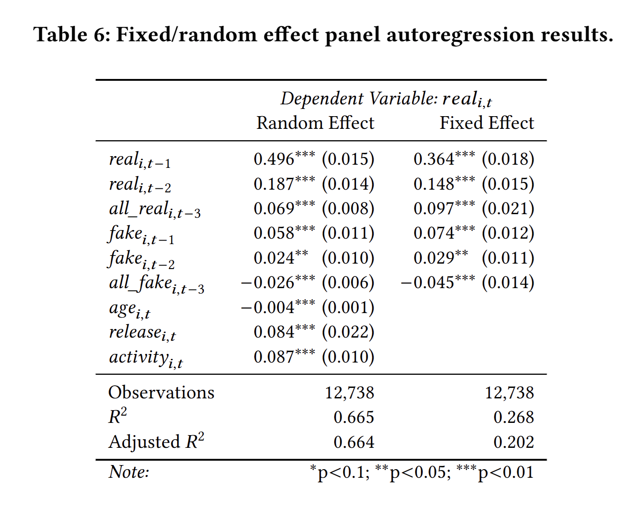
Completed Work: The Effect of Fake GitHub Stars
Fake GitHub Stars
increases
decreases
Short Term Real Stars
Long Term Real Stars
√(supported) Alternative Theory

Slide 28
The Impact of Cursor AI on Open-Source Projects
Empirical Study III
Hao He, Courtney Miller, Shyam Agarwal, Christian Kästner, and Bogdan Vasilescu. “Speed at the Cost of Quality: How Cursor AI Increases Short-Term Velocity and Long-Term Complexity in Open-Source Projects.” Accepted at the 23rd International Conference on Mining Software Repositories (MSR’26). Preprint: arXiv:2511.04427.

Slide 29
Completed Work: The Impact of Cursor AI Adoption
Research Question: Does Cursor bring sustained productivity benefits to software development (as measured by development velocity and software quality)?
increases
Cursor AI
Development Velocity
increases
Cursor AI
Software Quality
Candidate Theory (The Myth)
He, Hao, et al. "Speed at the Cost of Quality: How Cursor AI Increases Short-Term Velocity and Long-Term Complexity in Open-Source Projects." arXiv preprint arXiv:2511.04427 (2025). To appear in the 2026 23rd International Conference on Mining Software Repositories.

Slide 30
Completed Work: The Impact of Cursor AI Adoption
Method: Propensity Score Matching + Staggered Difference-in-Differences
Assumption for Causal Interpretation:
  (Parallel Trend) The treatment group and the control group would on average evolve similarly in outcome should the treatment (i.e., Cursor) never happened
Alternative Explanations:
  (Selection Bias) The two groups are different => matching + pre-trend tests
  (Sustainability Issues) Developers abandon the project => Robustness checks
  (Non-compliance) Developers stop using Cursor => Robustness checks
  (Dataset Pollution) Presence of other AI tools => Robustness checks

Slide 31
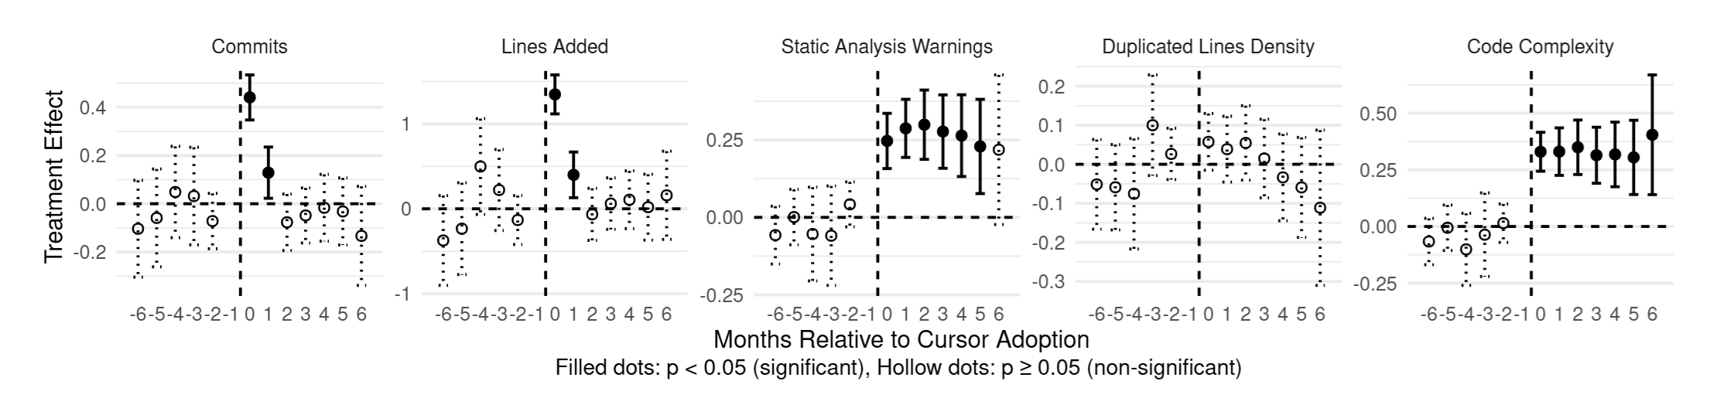
Completed Work: The Impact of Cursor AI Adoption
increases
Cursor AI
Development Velocity
increases
Cursor AI
Software Quality
×(dispelled) Candidate Theory (The Myth)

Slide 32
Completed Work: The Impact of Cursor AI Adoption
Frustration & Abandonment
-
Cursor AI Adoption
+
-
+
+
+
Velocity
-
Static Analysis Warnings
Code Complexity
-
√(supported) Alternative Theory

Slide 33
Thesis Statement
I argue that causal credibility assessments are feasible in empirical software engineering through an explicit articulation of causal theory and assumptions.
One feasible causal credibility assessment operationalization in SE settings is as follows:
  Derive a causal theory from existing SE domain knowledge
  Define a causal estimate of interest and the assumption under which the estimate would carry a causal interpretation through the potential outcome framework
  Honestly acknowledge and mitigate limitations in data collection, metric design, measurement infrastructure, and model specifications
  Thoughtfully navigate alternative explanations (i.e., alternative DAGs)
Notes:
Applying the thesis framework is feasible for dispelling software engineering myths and inform evidence-based practice. Do an educational paper instead of the migration

Slide 34
Thesis Statement
I argue that causal credibility assessments are feasible in empirical software engineering through an explicit articulation of causal theory and assumptions.
Notes:
Applying the thesis framework is feasible for dispelling software engineering myths and inform evidence-based practice. Do an educational paper instead of the migration

